Slide 1


Recall White Gaussian RP
White Gaussian random process
A Gaussian RV for each t (discrete)
Each sample has the same distribution (e.g., 0 mean, and var 1)
Independent RVs for different t, no matter how many samples
E.g. are independent RVs

Slide 2



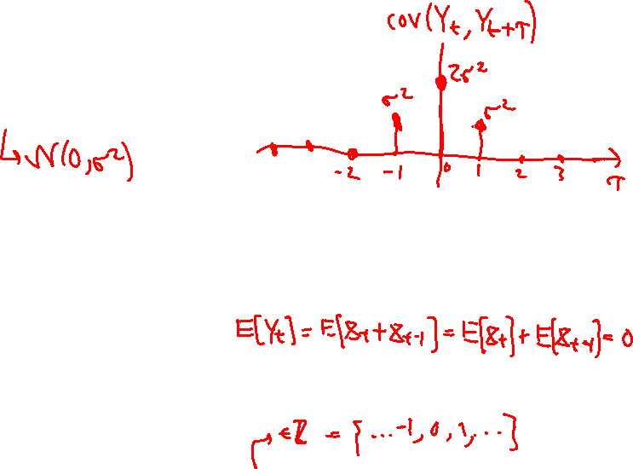
“Filtered” Gaussian RP
Moving average over the white RP
still Gaussian RV for each t (why?)
What are the expectation and variance of ?
Each sample has the same distribution
Not independent anymore!
Find covariance:
Only a function of the time difference!

Slide 3
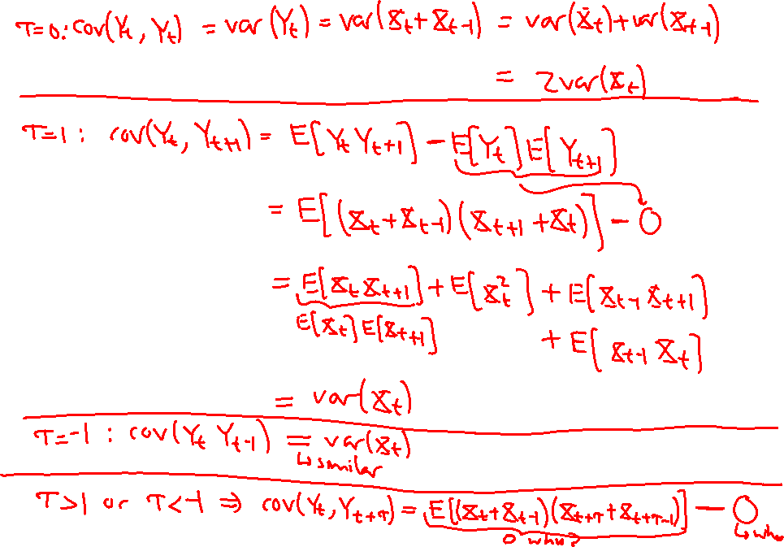

Slide 4
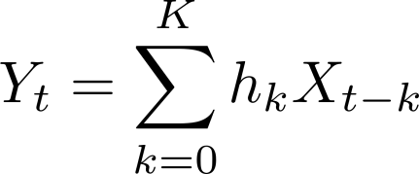
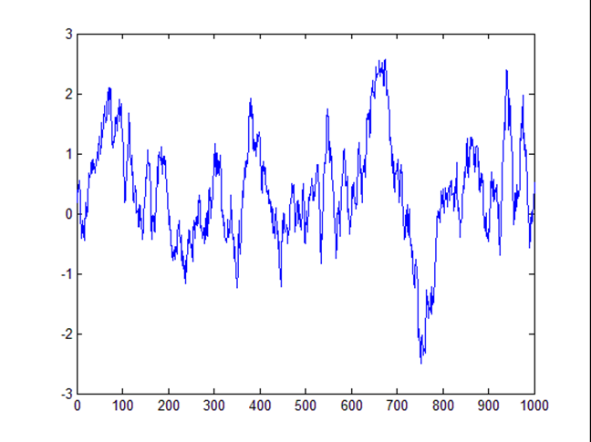
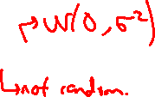
Filtered Gaussian Cont’
Moving average over the white RP
What are the expect. var. and cov. now?

Slide 5
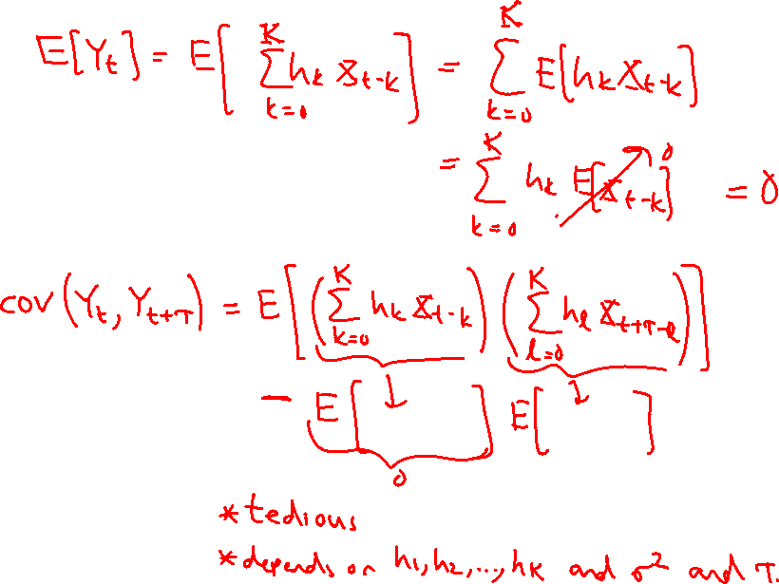

Slide 7
Acknowledgements and Citations
Parts of these slides are adapted from the following resources:
Power Point Lecture Slides for the Textbook http://bcs.wiley.com/hebcs/Books?action=index&bcsId=8676&itemId=1118324560
John Tsitsiklis. 6.041 Probabilistic Systems Analysis and Applied Probability, Fall 2010. (Massachusetts Institute of Technology: MIT OpenCourseWare),http://ocw.mit.edu (Accessed 13 Apr, 2015). License: Creative Commons BY-NC-SA

